Slide 1
Gateway Technical College & LakeView Academy
IT & Manufacturing Pathways
Gateway Technical College
Ray Koukari, Dean of Manufacturing, Engineering & IT
Katie Graf, Director of High School Partnerships

Slide 2
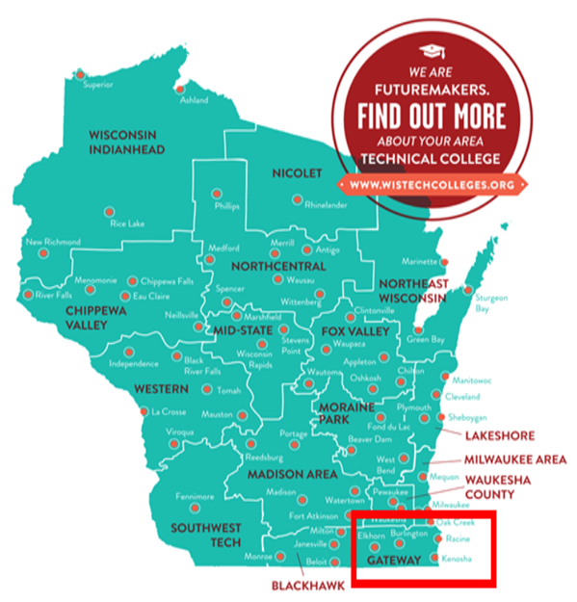
Gateway Facts
One of 16 colleges in the Wisconsin Technical College System
Founded in 1911
Serve approximately 20,000 students annually
Three main campuses split across a tri-county district
Five discipline-specific technology centers
14 public school districts & 9 private high schools
Guided Pathways School

Slide 3
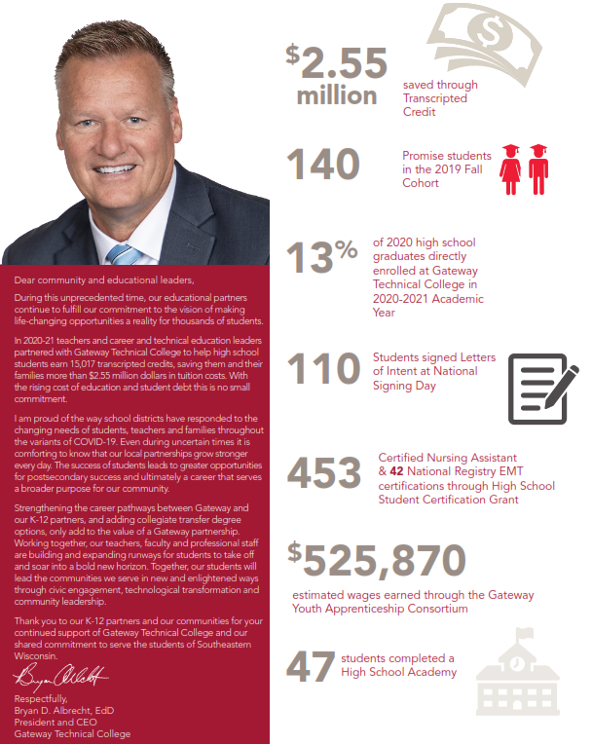
Gateway Supporting High Schools

Slide 4
High School Dual Credit Opportunities
Path to Success
Transcripted Credit
Career Pathway Grants
Advanced Standing
Start College Now
Contract For Service (38.14)
High School Academies
Grant Funded or 38.14 Contracts
Youth Apprenticeship
VANguard (Distance Learning)

Slide 5
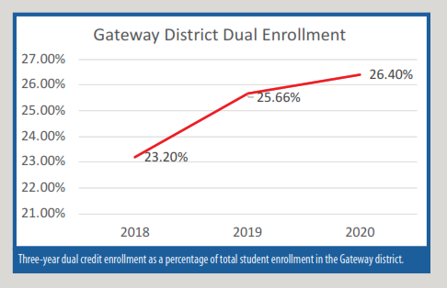
Gateway District Dual Credit

Slide 6
LakeView Academy History
Started in 2007
LakeView Academy serves as our model
Lessons learned in first two years:
English/Math
Calendars
Two full time faculty & one part-time faculty

Slide 7
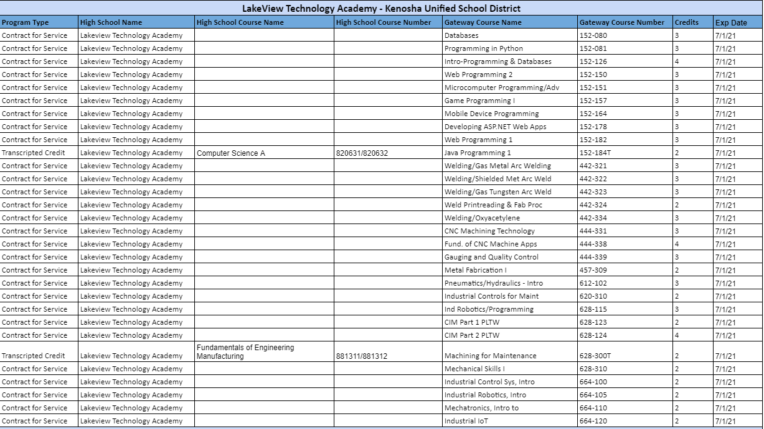
LakeView Academy Articulation Agreements
2020-2021

Slide 8
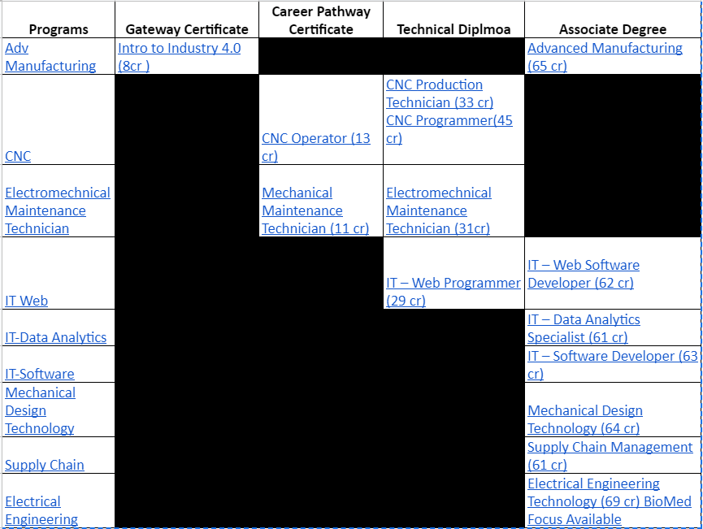
LakeView Academy Program Overview

Slide 9
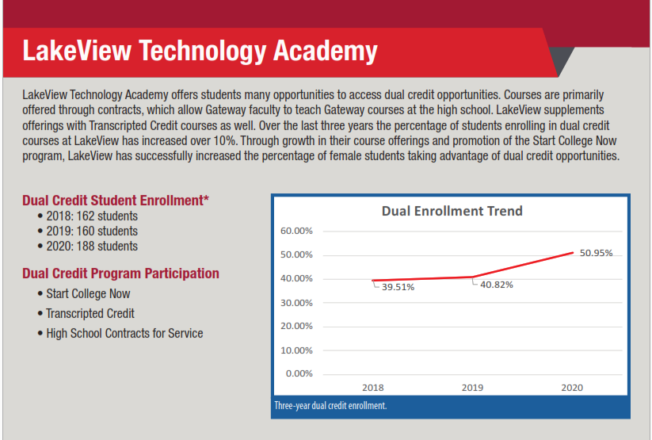
LakeView Technology Academy Dual Credit

Slide 10
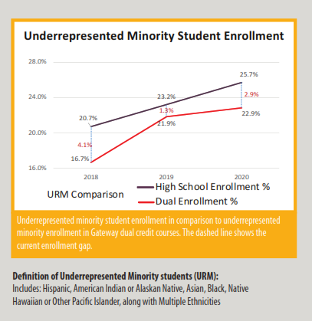
LakeView: Dual Credit Equity

Slide 11
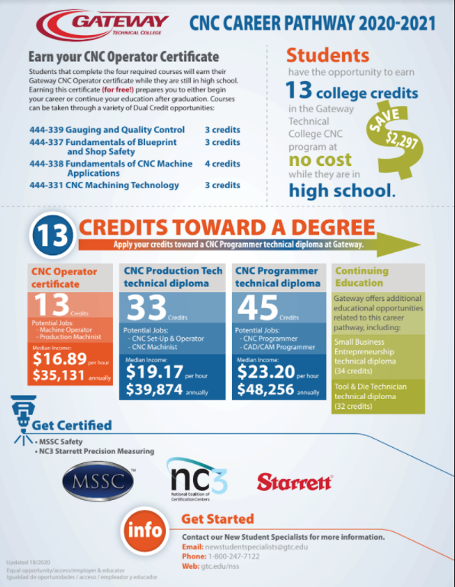
LakeView Outcomes
High School Students Earning College Credits while in High School
Class of 2021, 33% LakeView students earned at least 12 Gateway Credits
Credentials Earned while in High School (ACT 59 Eligible)
Gateway Certificate: Intro to Industry 4.0
Career Pathway Certificate: Mechanical Maintenance Technician
Career Pathway Certificate: CNC Operator
Continuing on at Gateway
Six Year Average Direct Enroll: 18%
Students continuing on in their program of study: IT & Manufacturing
Students are able to reduce the time to completion, graduate earlier, and enter the workforce earlier

Slide 12
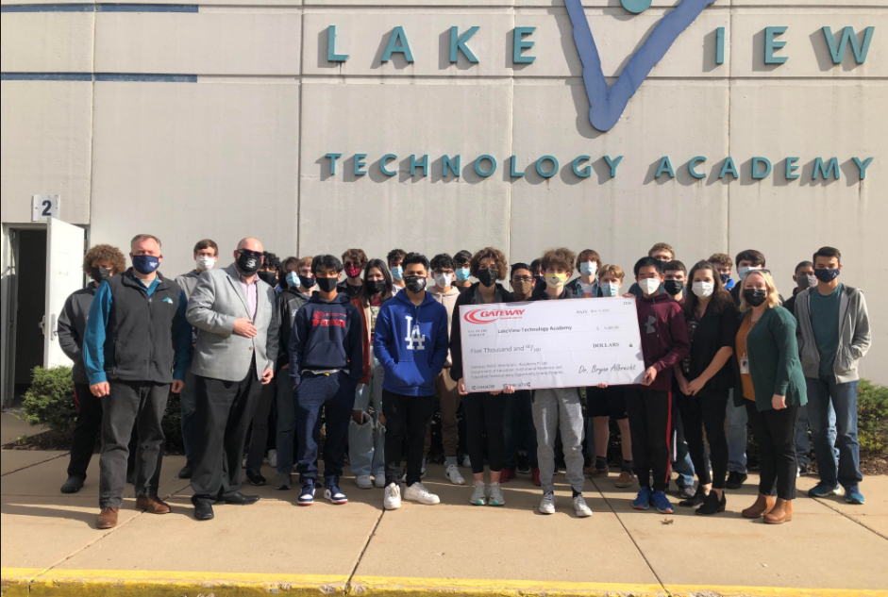
High School Perspective:
True Partnerships
“Our partnership with Gateway has been integral to the growth of our programs, our academic pathways, and the post-secondary success of many of our students. The opportunities granted through this relationship have been immensely meaningful and impactful educational experiences that truly embody our goal as educators to produce college and career ready students.”
-Jason Creel, Interim Principal
Visit the LakeView Academy Students Today!
Grants:
Private Donor SMART Manufacturing
FREE courses, Scholarships, Laptops
VOICE Mini-Grants

Slide 13
Expansion: REAL School, Waterford Union High School & MORE!
REAL School
Students attend classes at Gateway’s iMet Center
360 Students in grades 9-12
9th Grade: Exploration
10th-12th Grade focus on:
CNC
Advanced Manufacturing
Electrical Engineering
Waterford Union High School
Gateway’s faculty teaches at Waterford Union High School M-TH
Welding/Maintenance & Fabrication Technical Diploma 16 Credits

Slide 14
Best Practices & Resources
Gateway Technical College Resources:
Infographics
Gateway Technical College HS Annual Report 2019-2020
gtc.edu/earn-credit
Gateway Technical College
Ray Koukari koukarir@gtc.edu
Dean of Manufacturing, Engineering & IT
Katie Graf grafk@gtc.edu
Director of High School Partnerships

