Slide 1
Student Built Homes
Portage and Rapids Style
Terry Bores – Lincoln High School Wisconsin Rapids
Josh Krueger – Portage High School

Slide 2
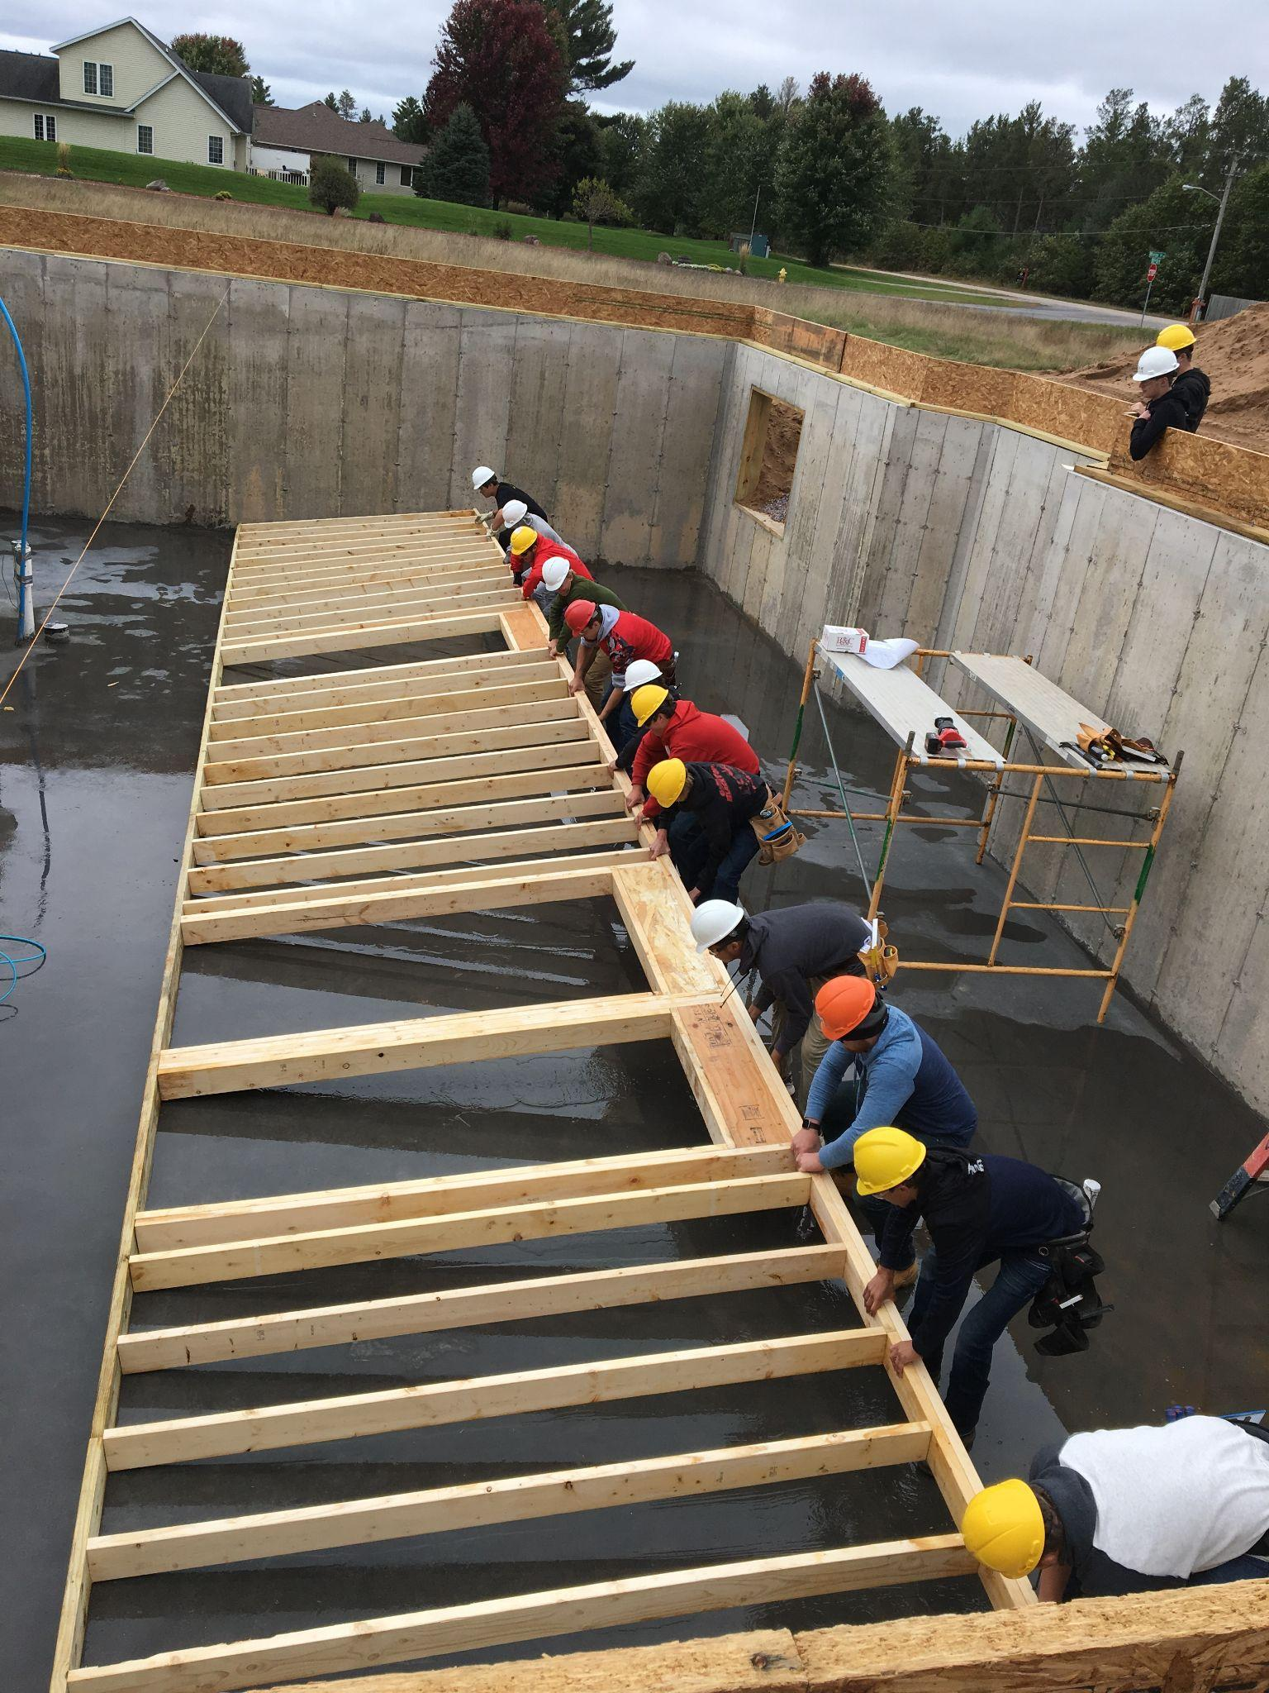
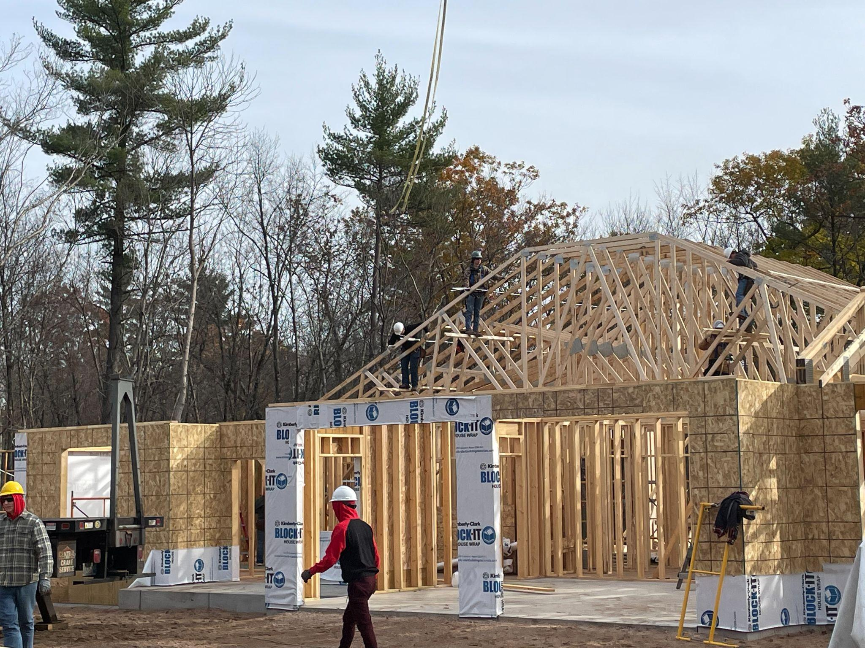
Student Built Homes
History of start-up
School schedule
Safety (OSHA 10)

Slide 3
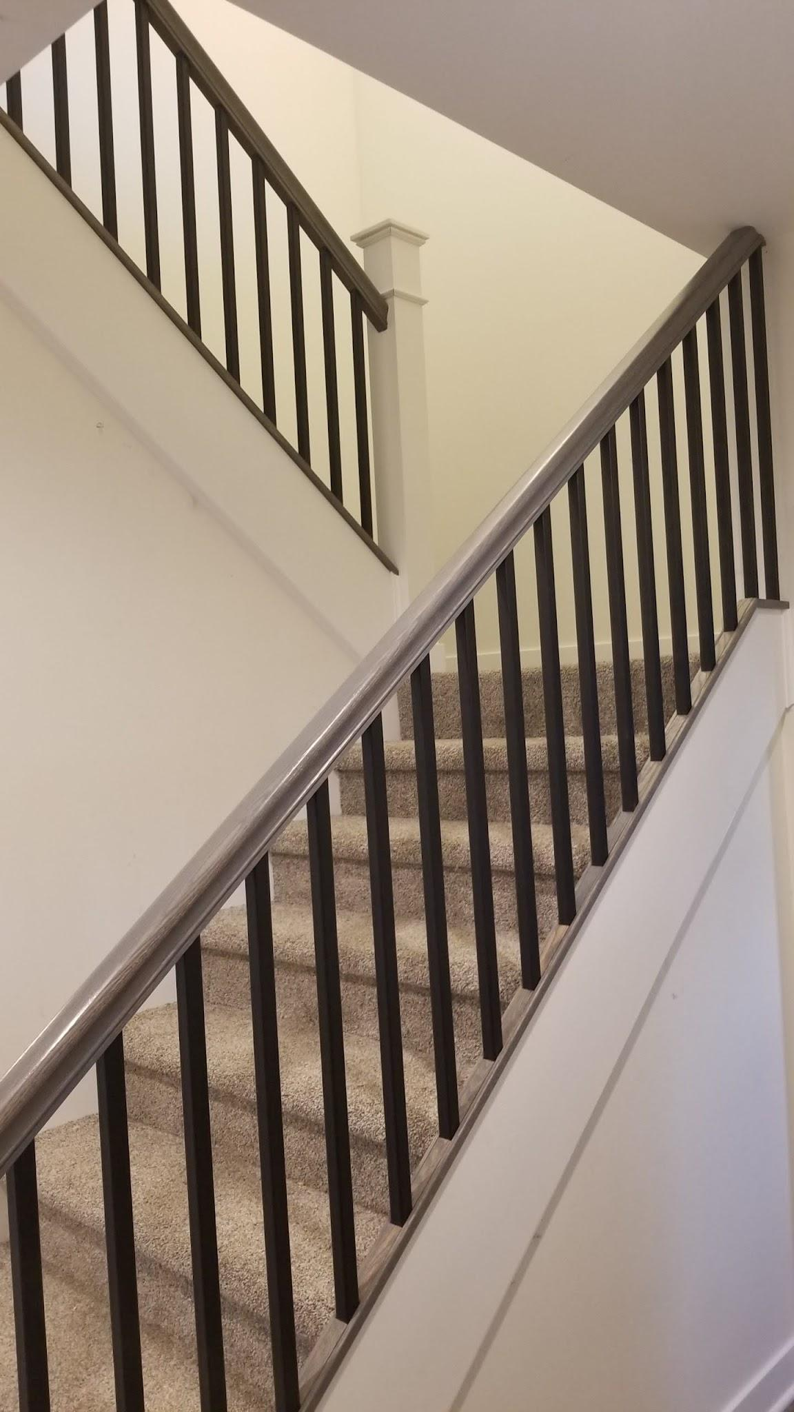
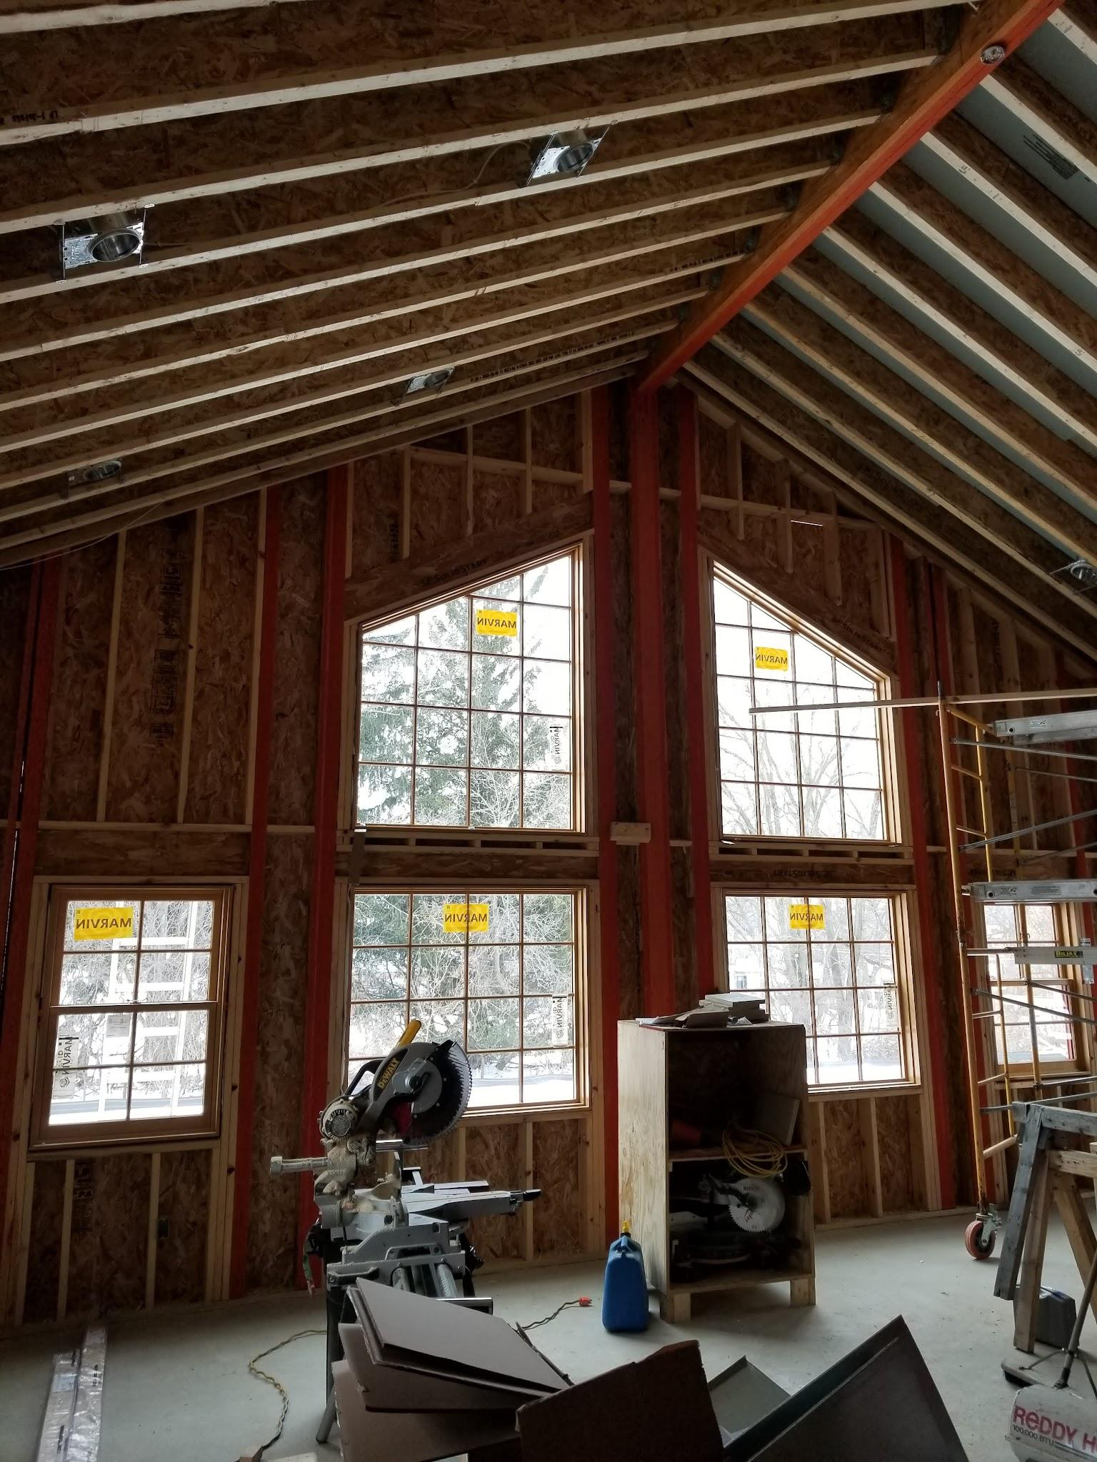
Portage Building Trades
Types of homes
Spec homes built and sold by the School
Homes built for Customers
Single story homes
Two story homes
Buildings built for the school district
1900 sqft transition house for high needs students

Slide 4
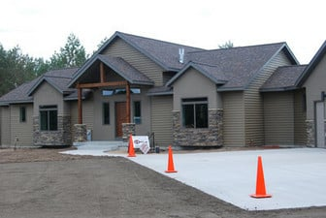
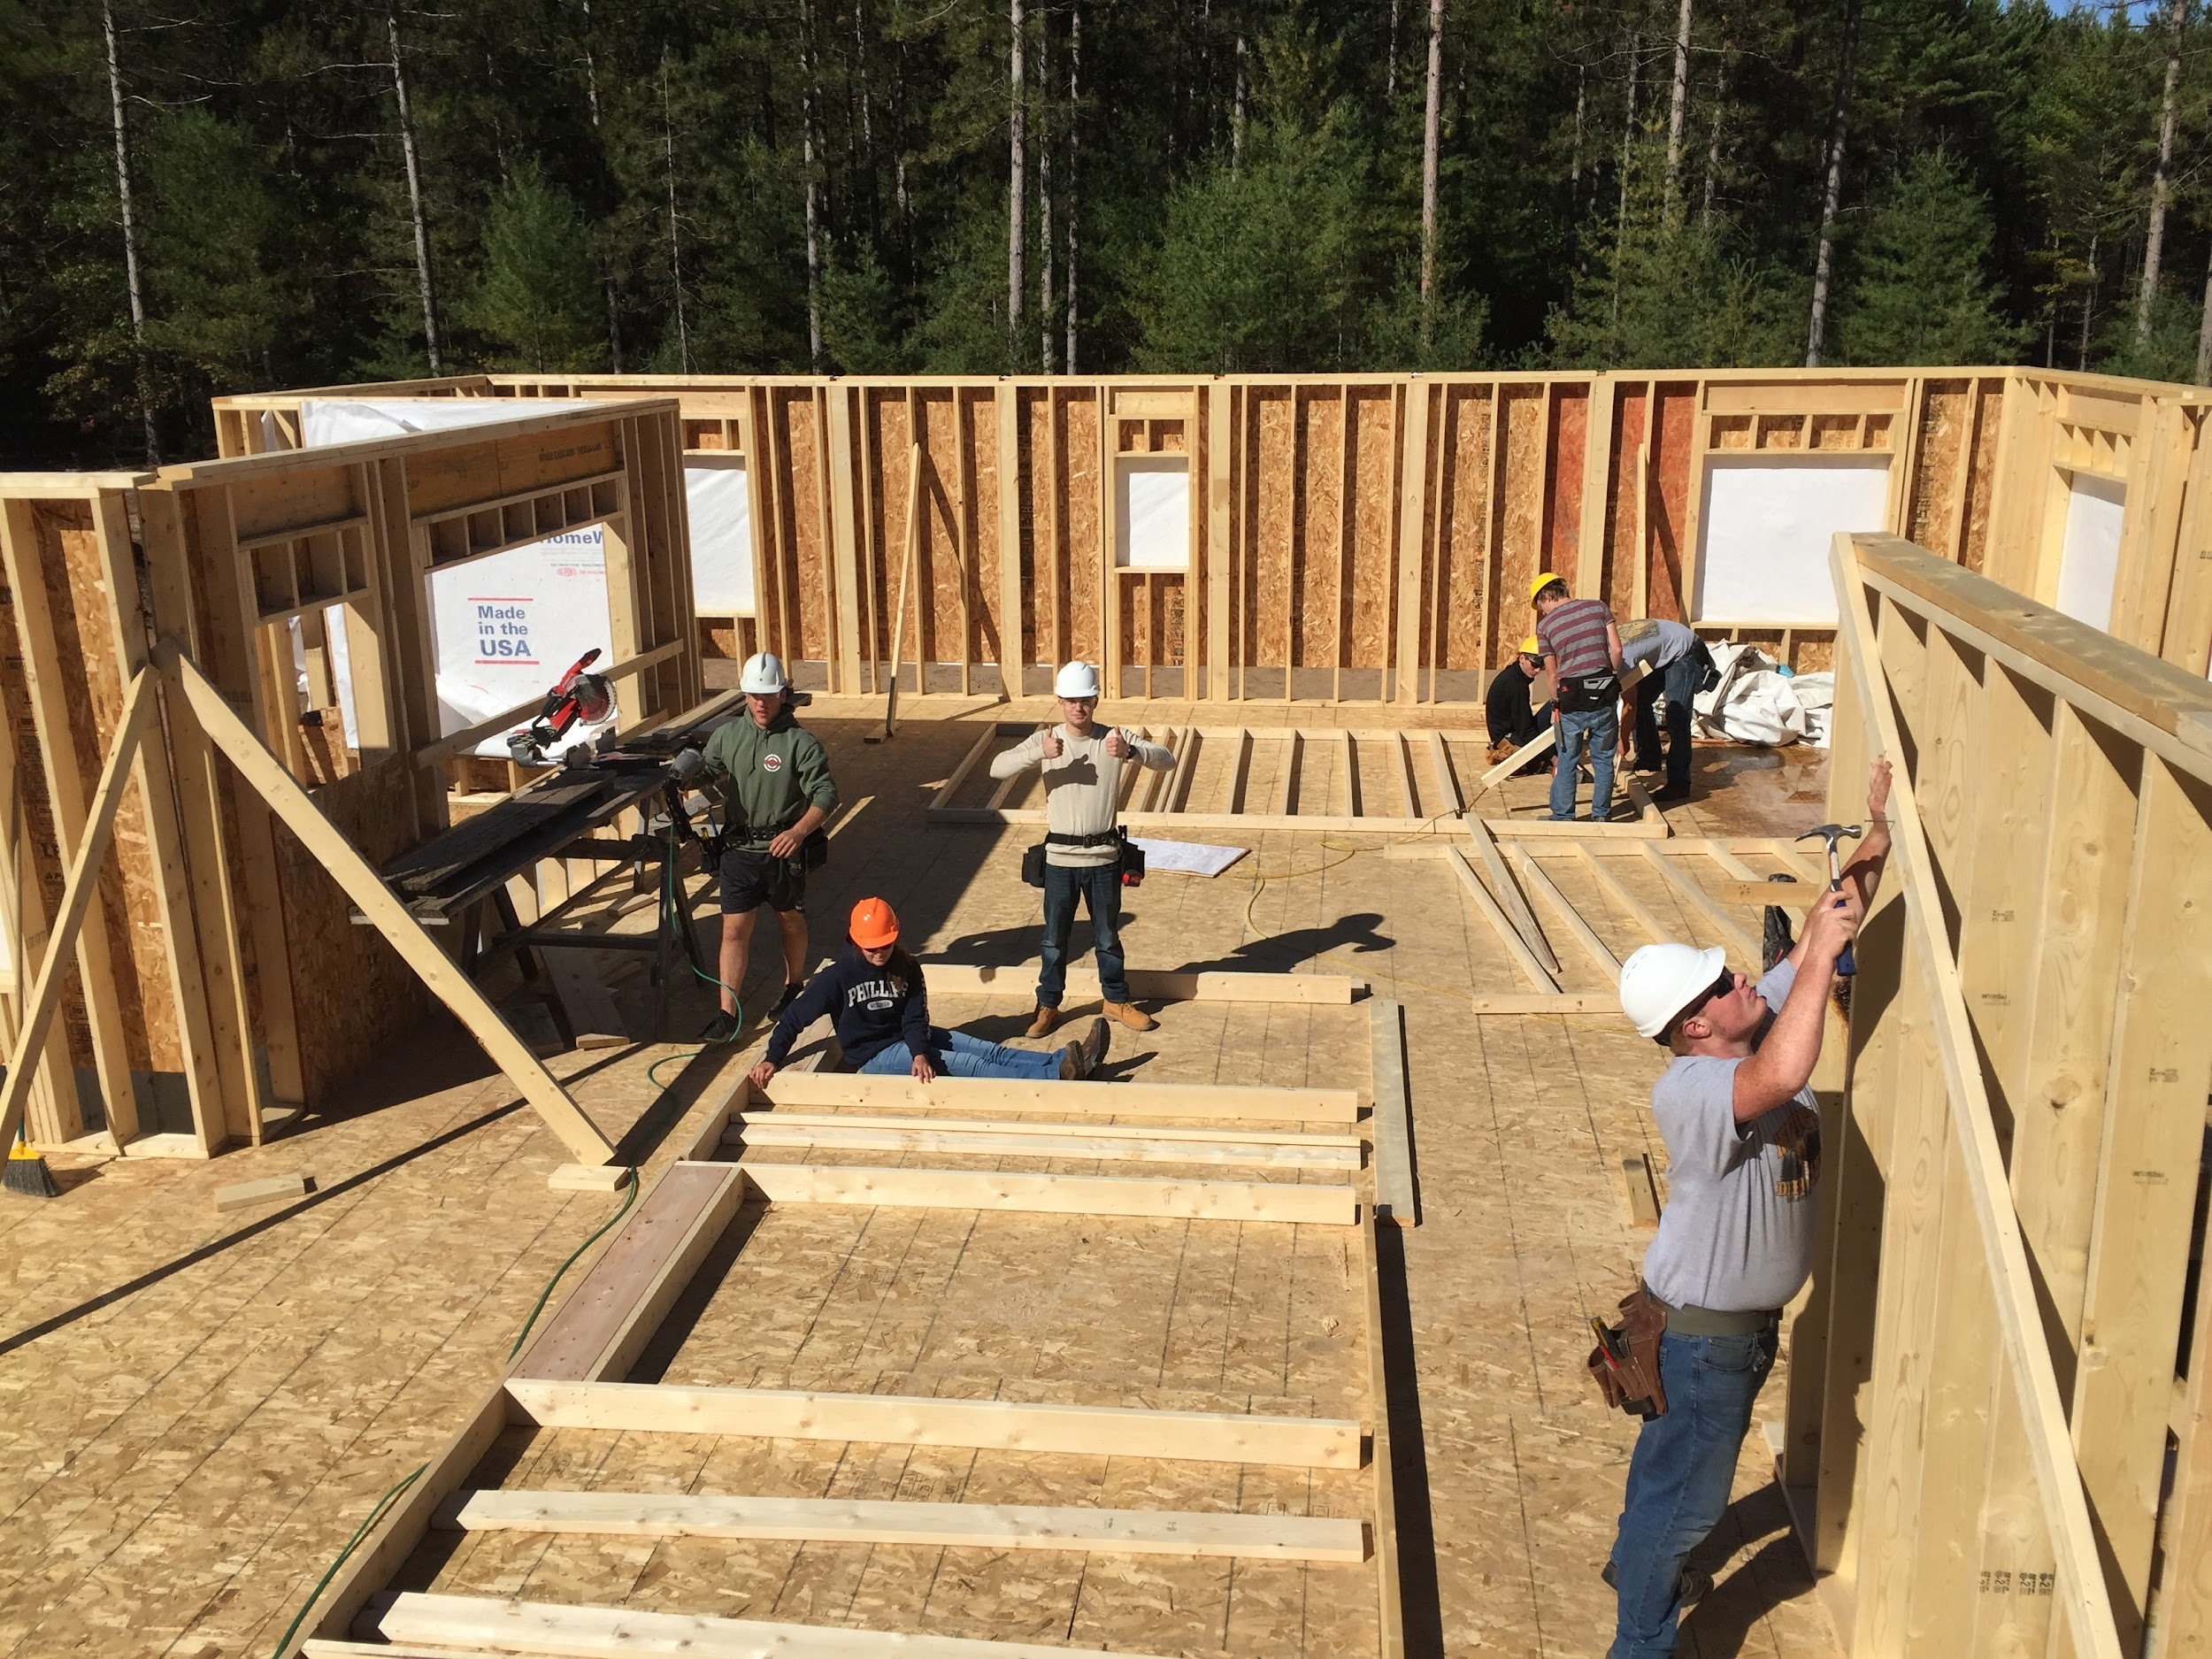
Lincoln Building Construction
Types of Homes
Custom built homes for customers
Single Story Ranch style homes
Walk out basements
On slab
Zero Entrance
Spec Homes
Only when we must.

Slide 5
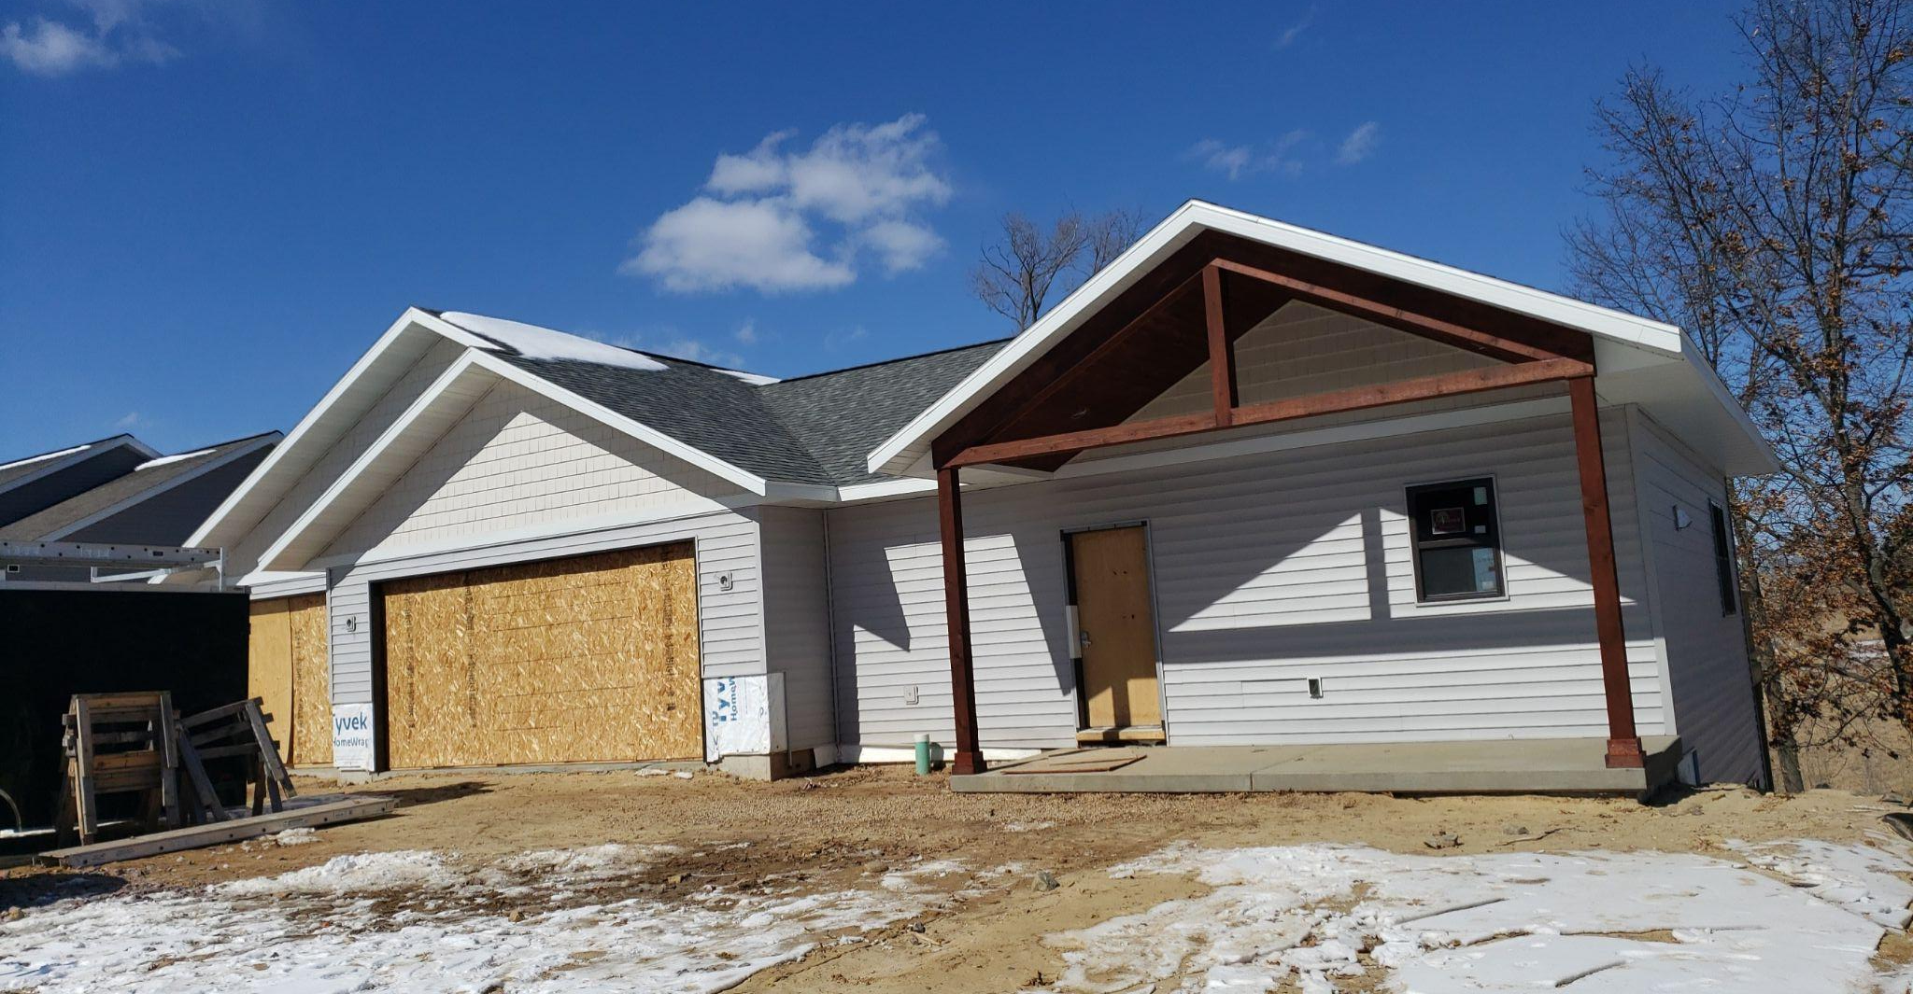
Selection of Home Portage
In Portage the selection process works like…
School built spec houses are the norm
Customer builds by word of mouth
Customer builds
take priority

Slide 6
Selection of the Home
In Rapids this process starts in late November
Advertising (website, radio, newspaper, word of mouth)
Letter of interest sent to the Board Office.
Follow up information sent back to the board office.
Lot location, Blueprint, Banking approval

Slide 7
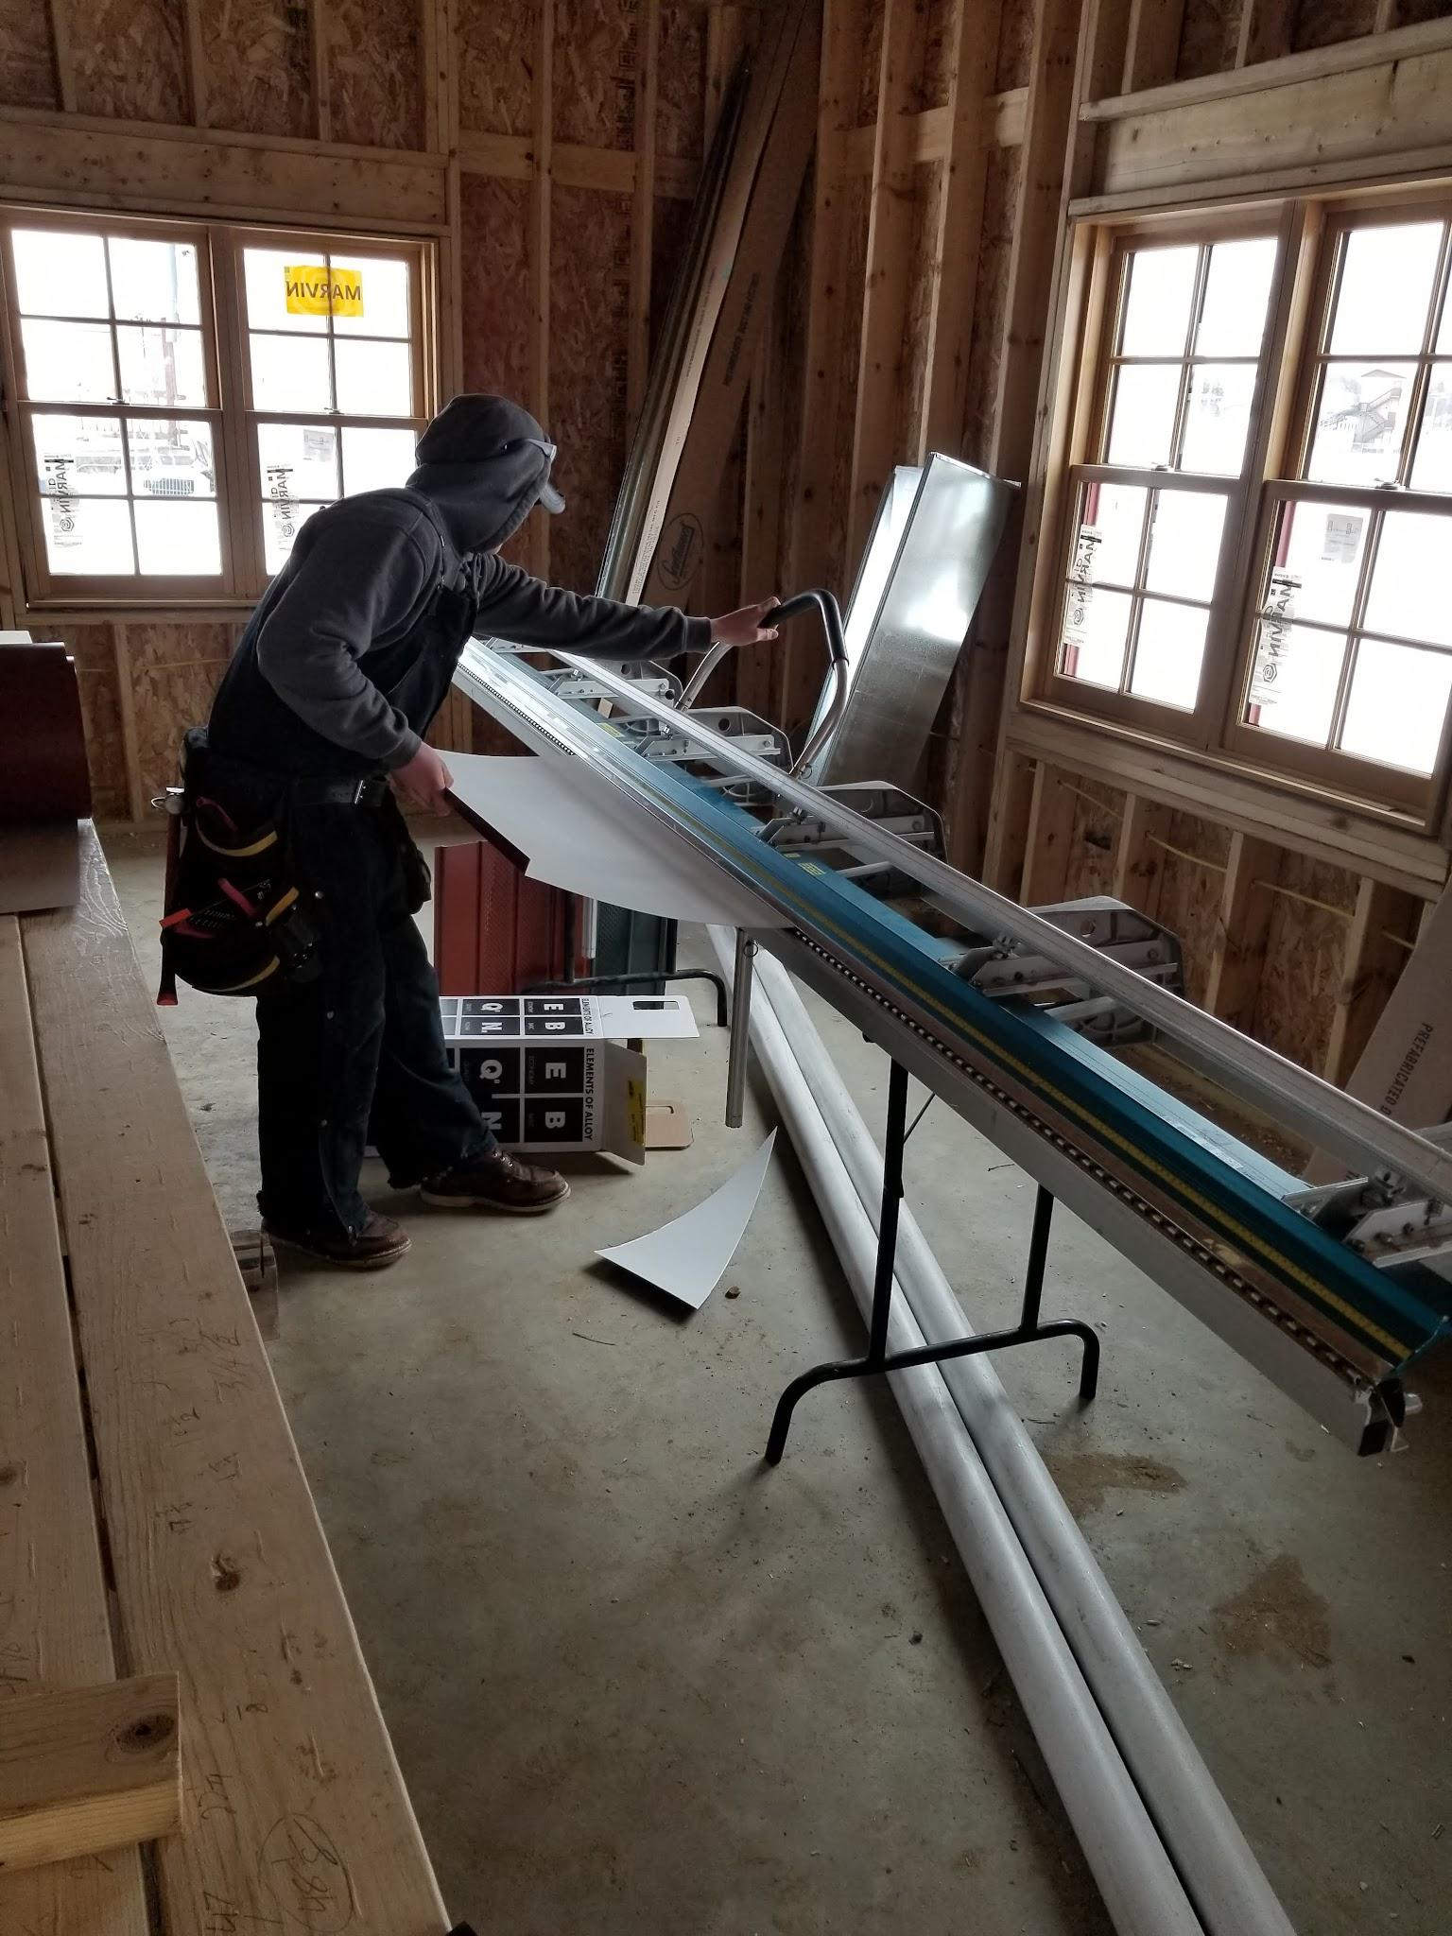
Portage Building Trades
Student selection
Must take prerequisite courses
They have two options
Encourage them to take both
Junior / Senior Year
Sign up
Fill out a job application
Interviews if necessary to lower numbers

Slide 8
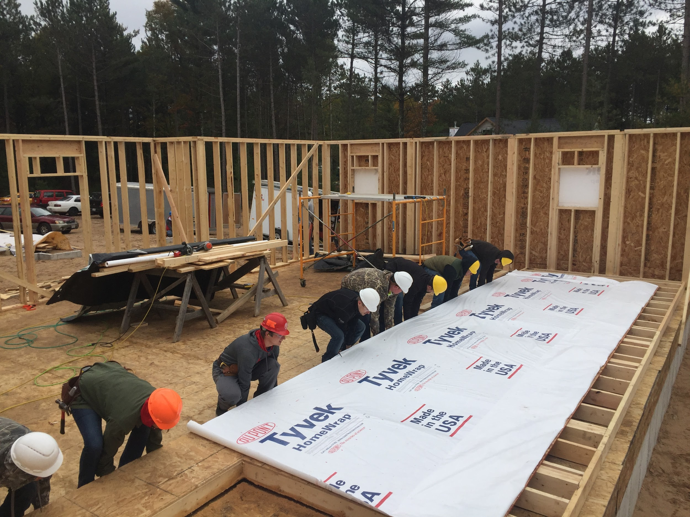
Rapids Building Construction
Student selection
Juniors or Seniors
Juniors are not encouraged because of the Trimester schedule
We do not have a course prerequisite
Course offerings
But, Students are removed from the course list based on a couple of factors.
Prior Attendance
Performance in other courses
Discipline record

Slide 9
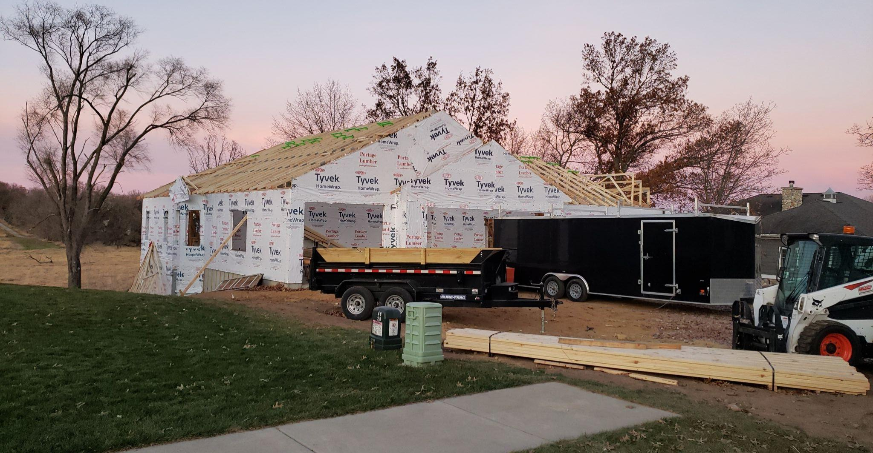
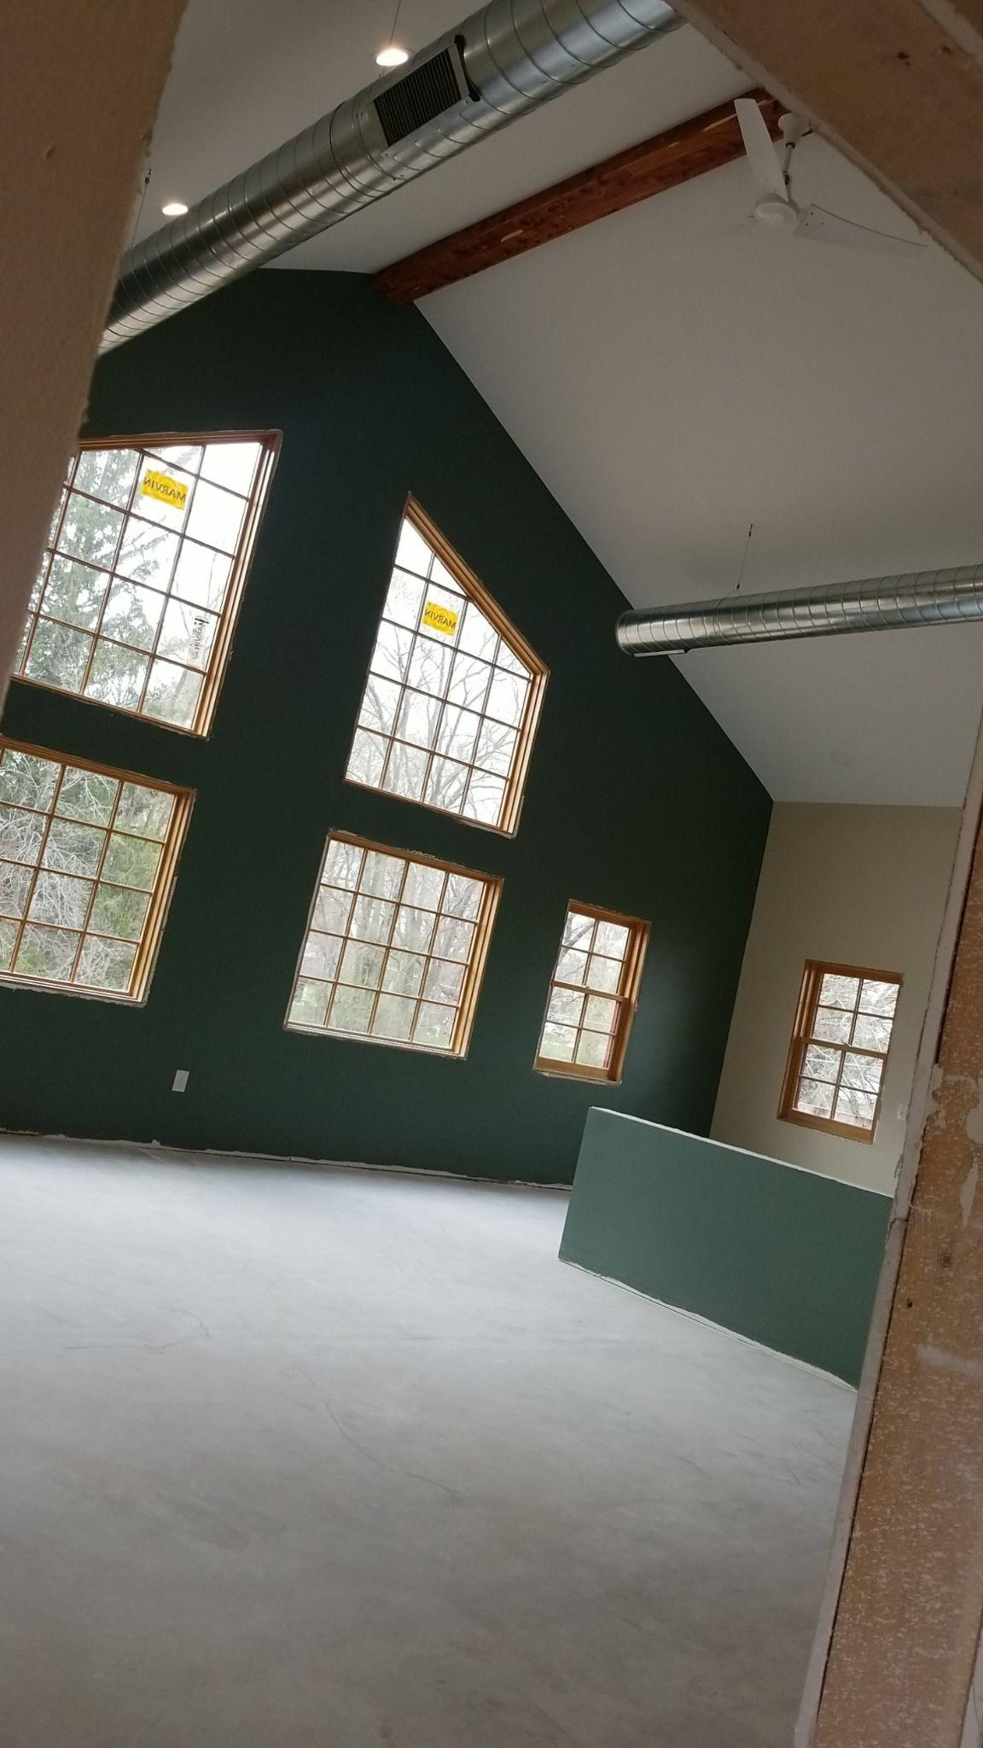
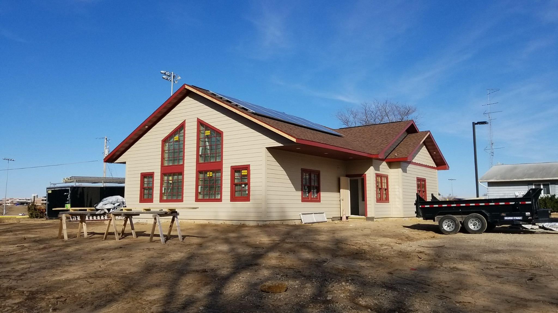
Behind the Scenes
Permitting
Funding
Blueprints
Lot Location
Subcontractors
Receiving Bids
ACT 59 $$

Slide 10
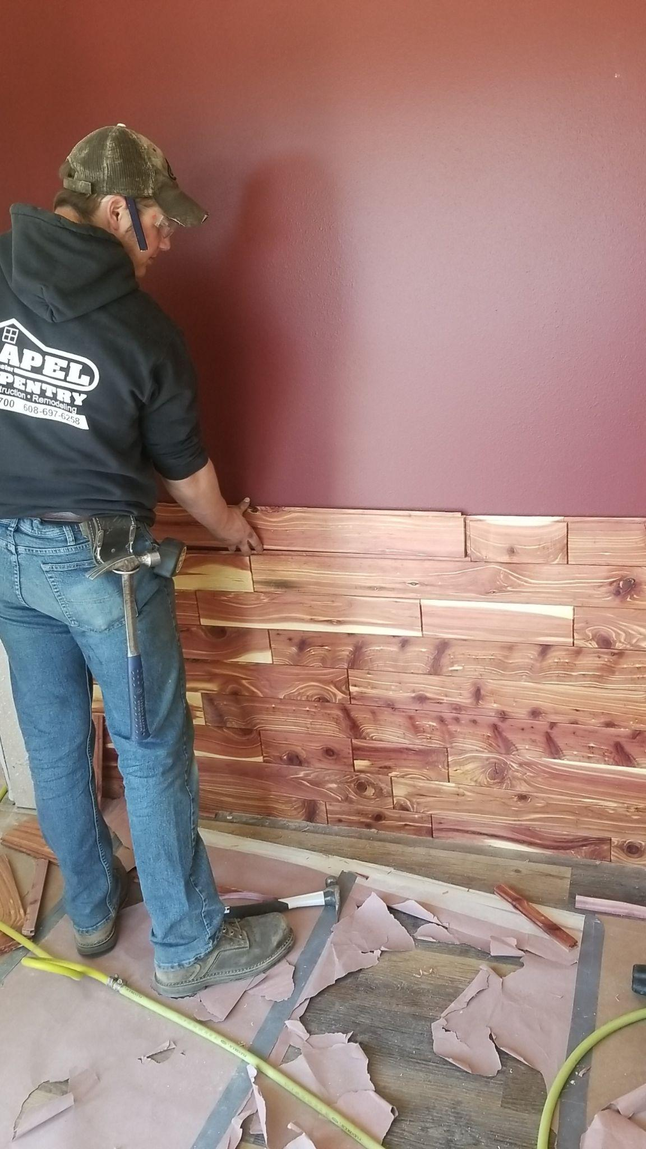
Custom Items

Slide 11
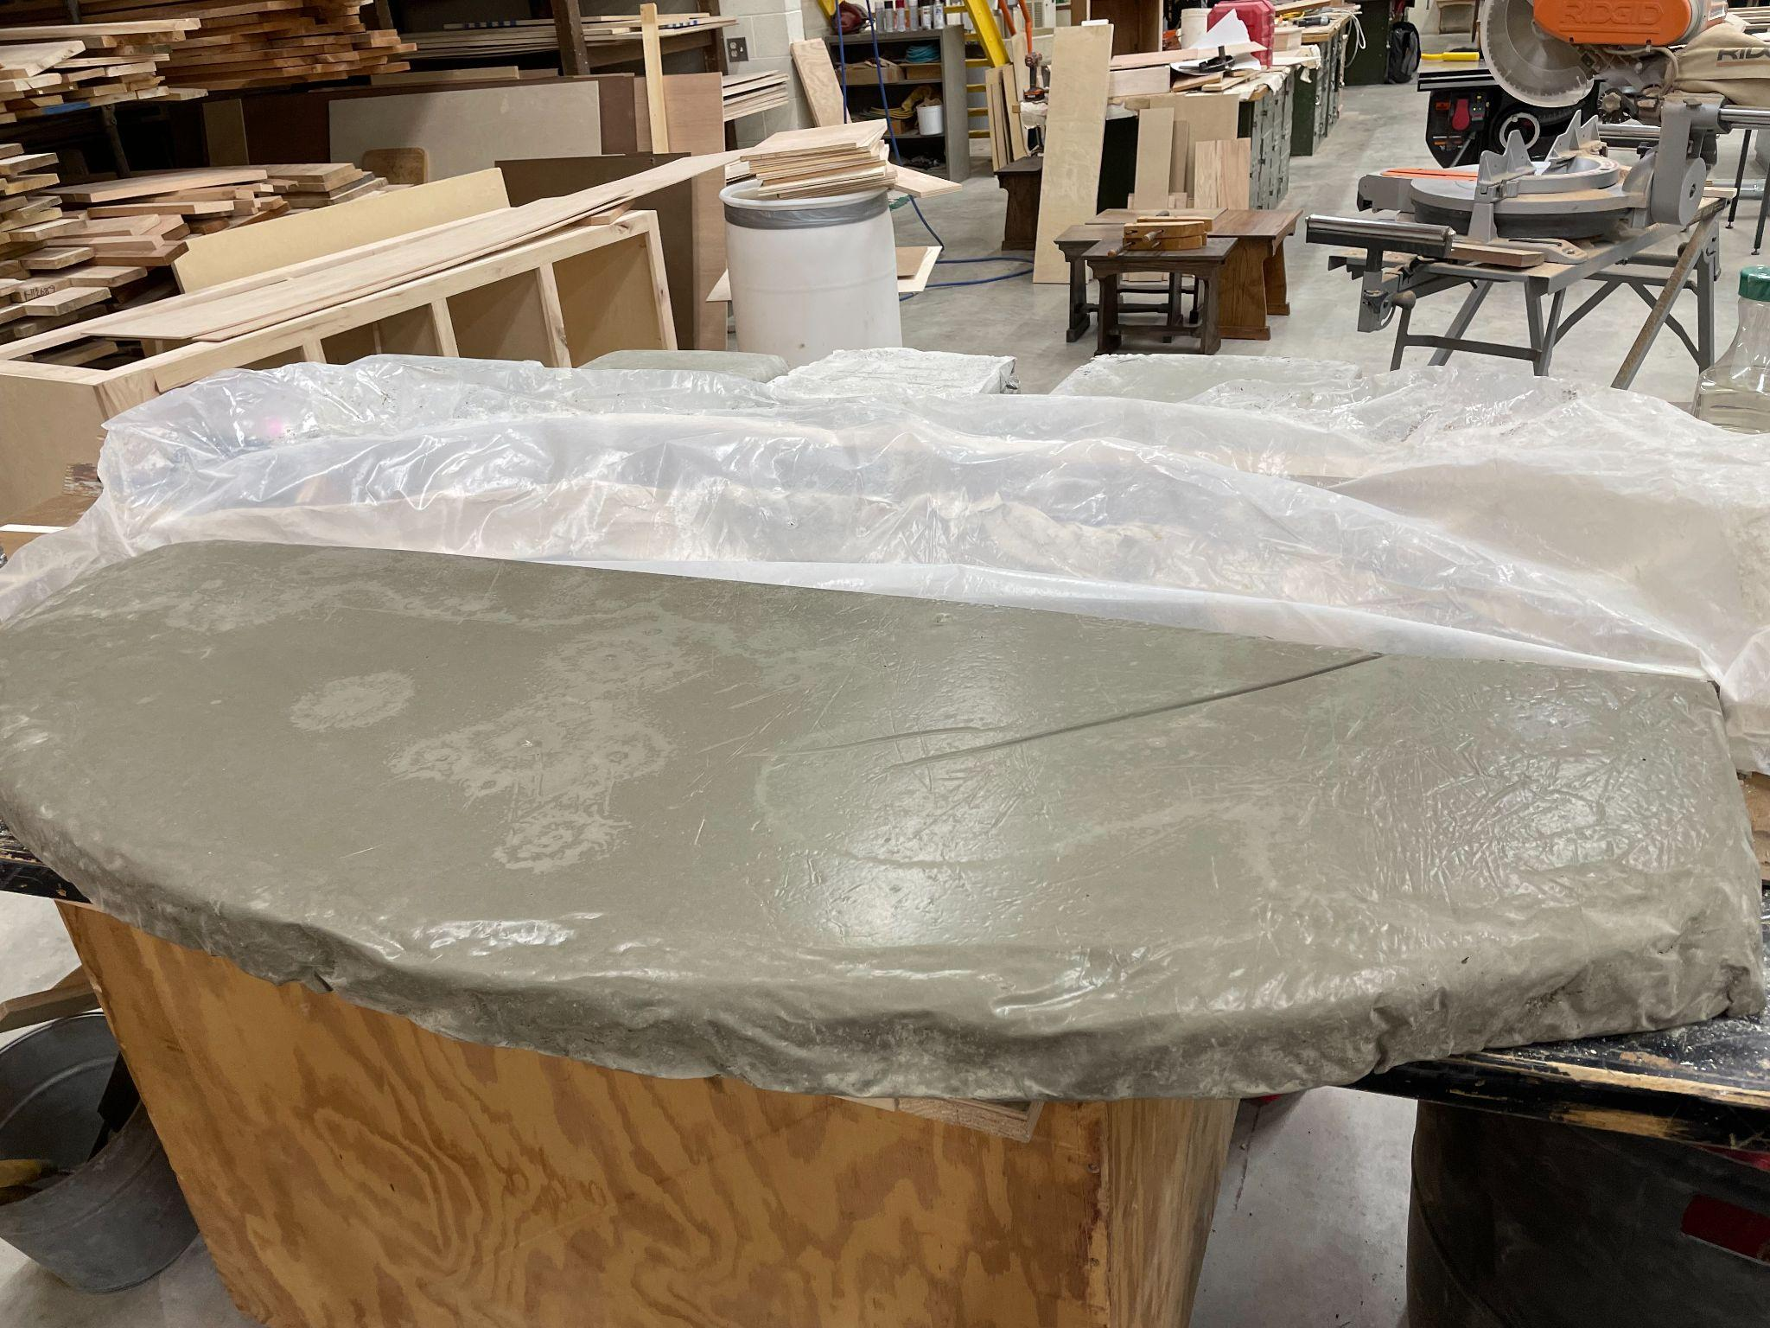
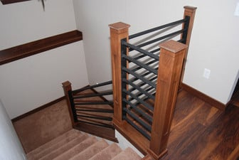

Slide 12
What your administrators should know!
Builds a great deal of confidence
Machines and tools
Terminology
Working on a site
Communicating without a device!!
Ready for the workforce!!
Builds great relationships between students ( like a sporting team)
Contractors working with students
Allows students to find their niche
Can be life changing experience

Slide 13
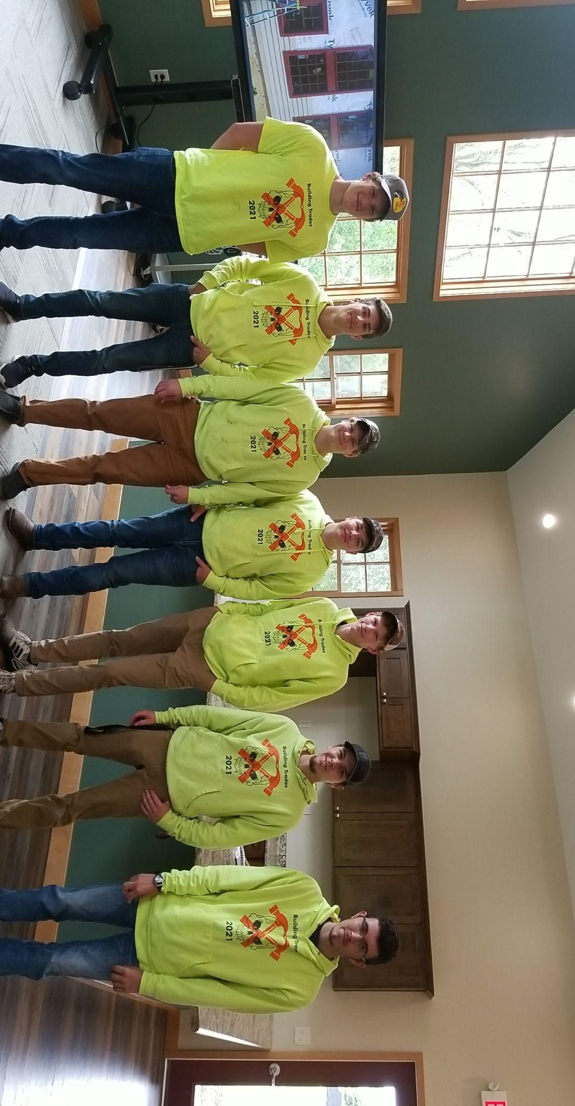
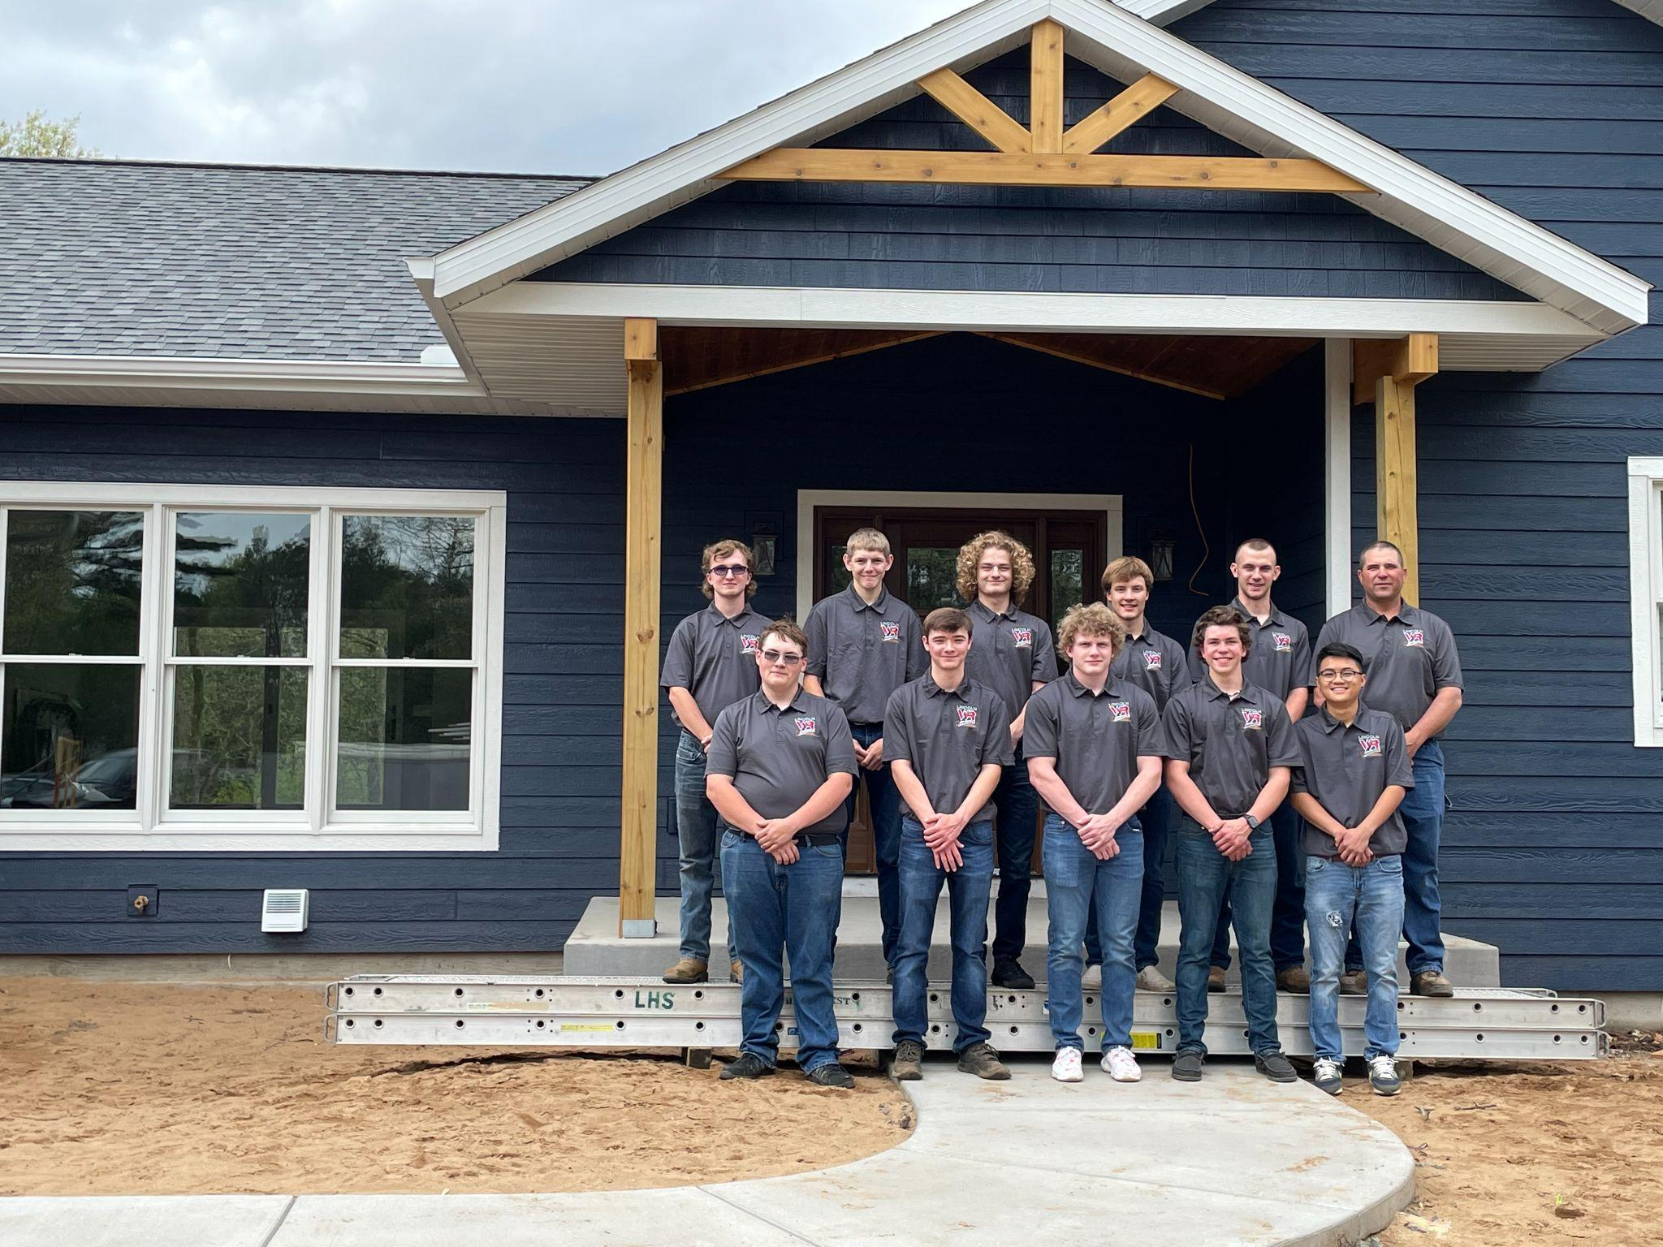
Questions
Terry Bores: Terry.Bores@wrps.net
Josh Krueger: kruegerj@portage.k12.wi.us

